Slide 1
Task 1
Name : Yogesh Nema E-mail: yogeshnema16@gmail.com Contact no.: 8982398320
Internship Studio’s Ethical Hacking Internship

Slide 2
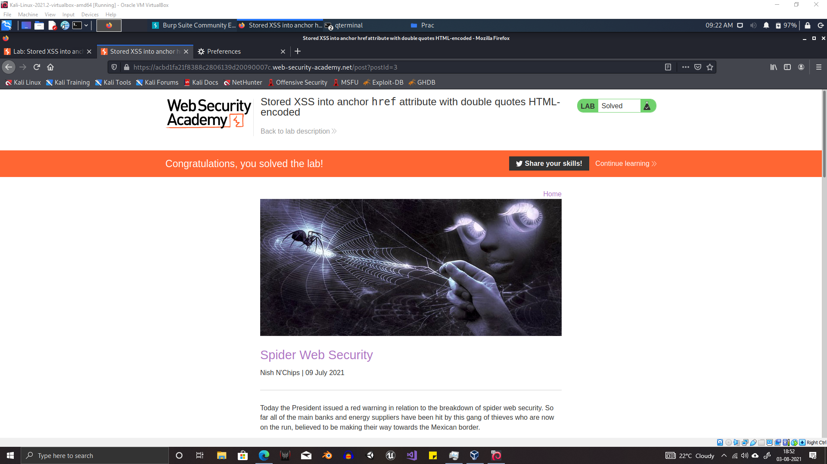

Slide 3
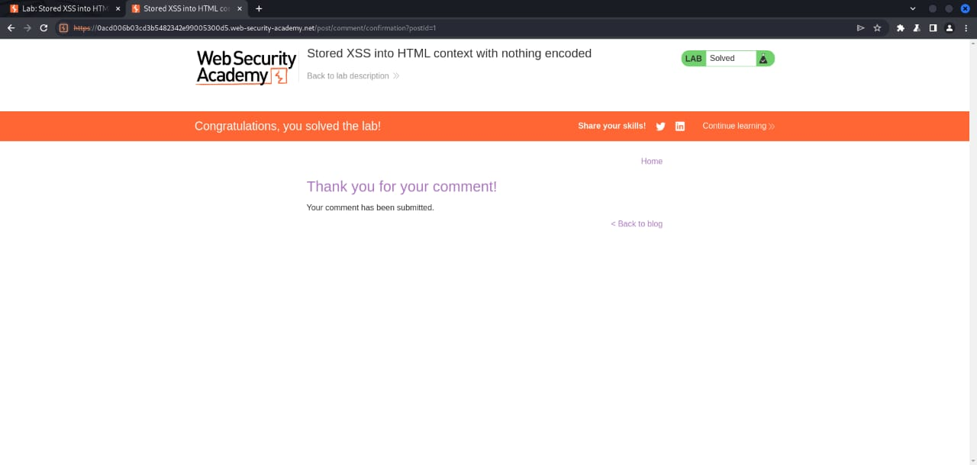

Slide 4
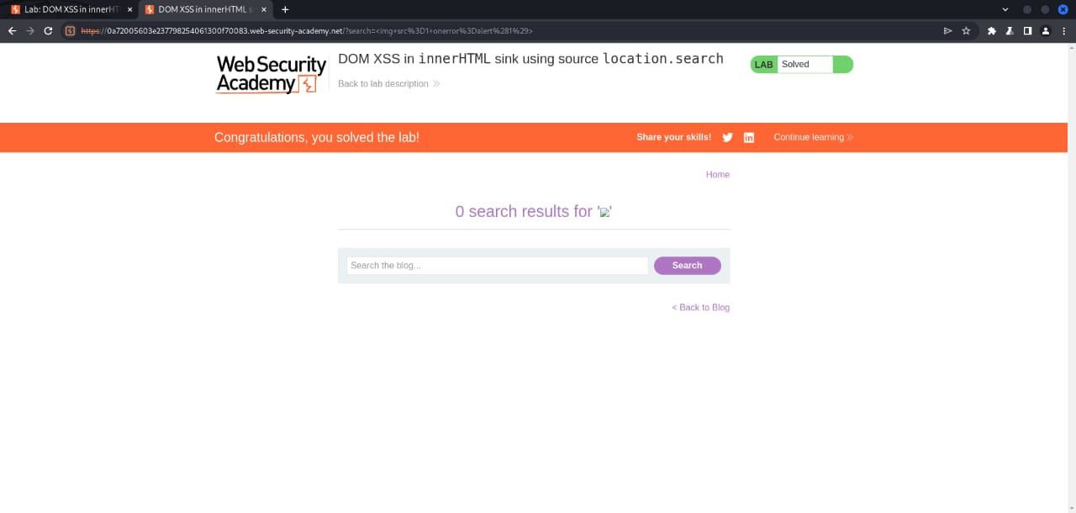

Slide 5
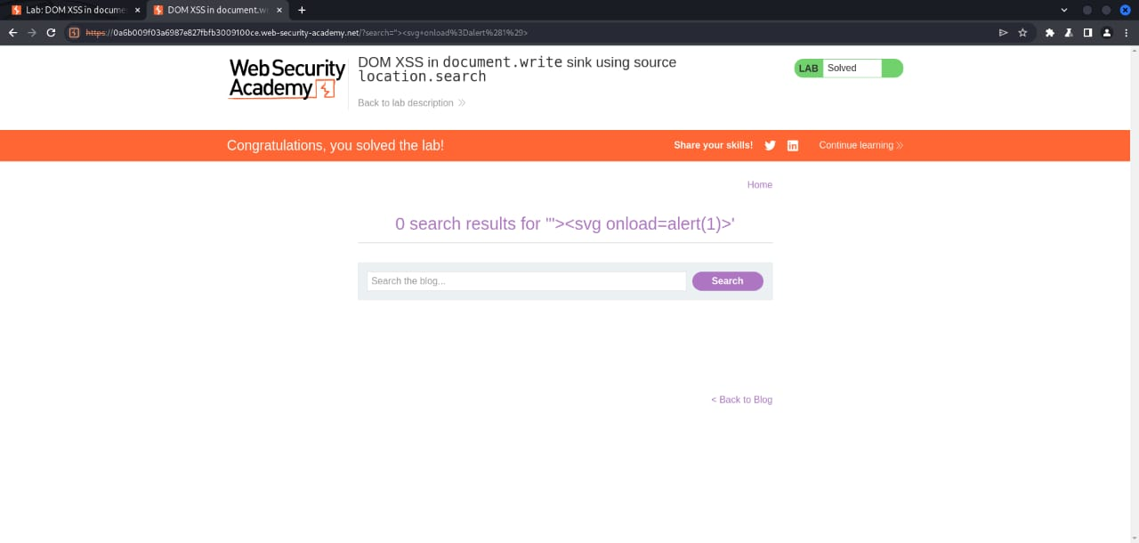

Slide 6
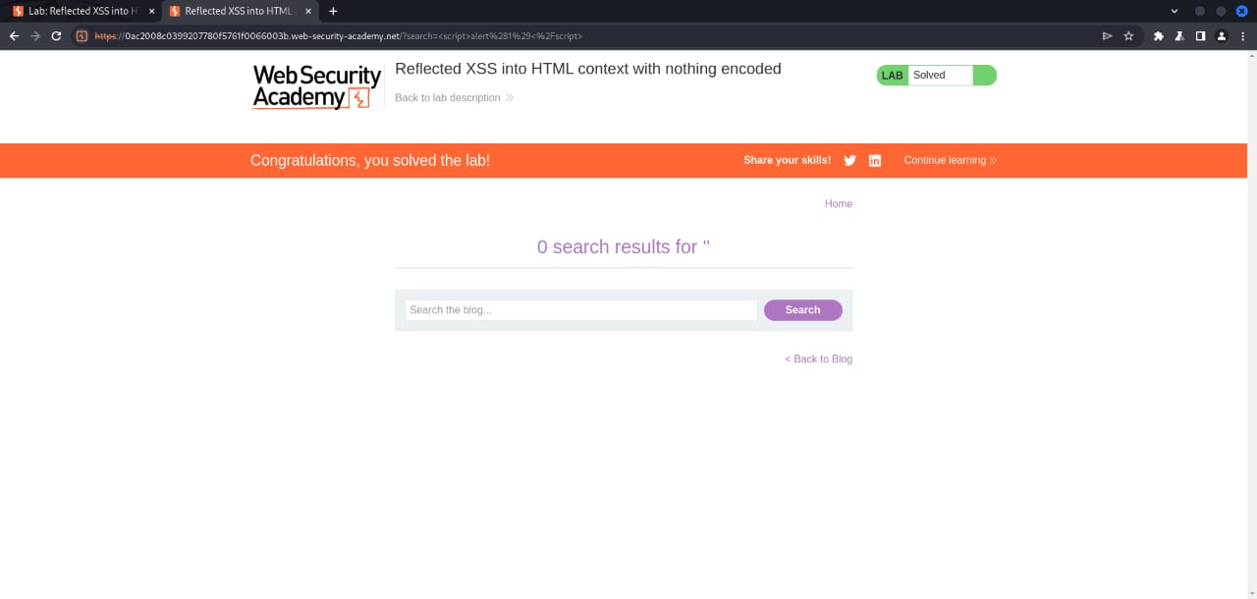

Slide 7


Thank You

